Slide 1
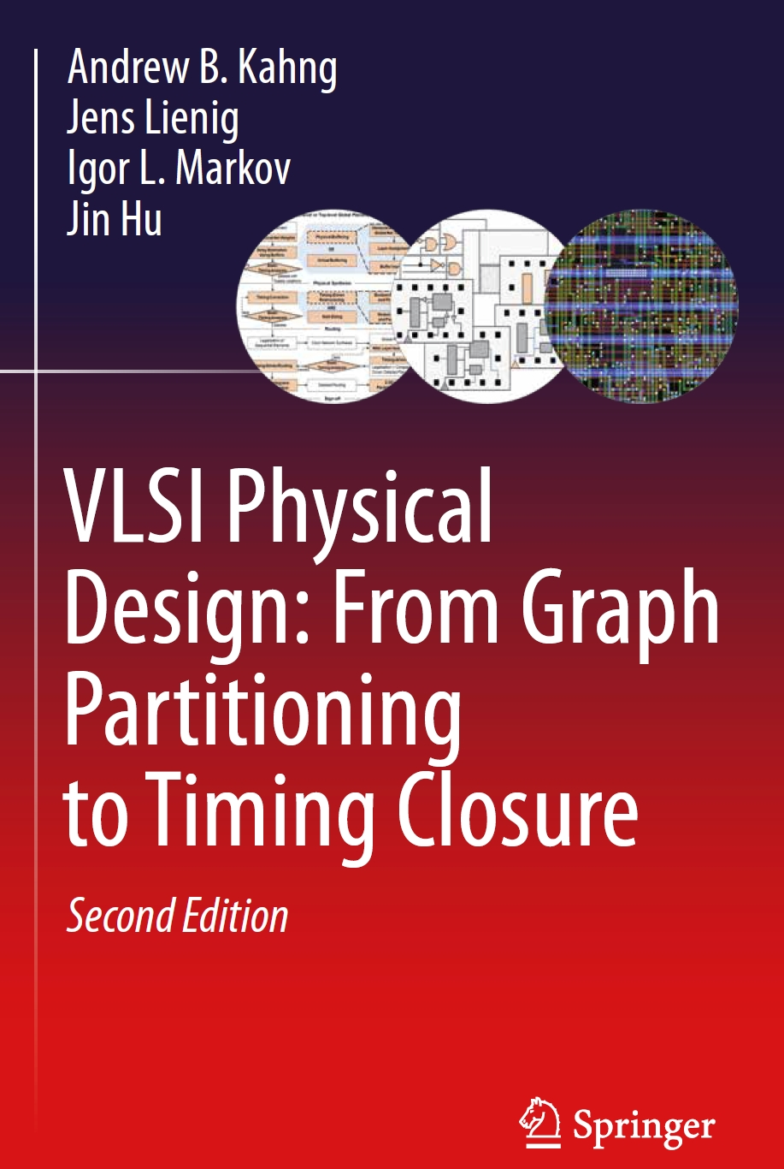
Chapter 1 – Introduction

Slide 2
Chapter 1 – Introduction
1.1 Electronic Design Automation (EDA)
1.2 VLSI Design Flow
1.3 VLSI Design Styles
1.4 Layout Layers and Design Rules
1.5 Physical Design Optimizations
1.6 Algorithms and Complexity
1.7 Graph Theory Terminology
1.8 Common EDA Terminology

Slide 3
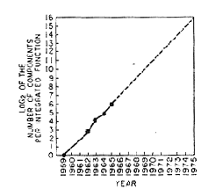
1.1 Electronic Design Automation (EDA)
Moore’s Law
In 1965, Gordon Moore (Fairchild) stated that the number of transistors on an IC would double every year. 10 years later, he revised his statement, asserting that they double every 18 months. Since then, this “rule” has been famously known as Moore’s Law.
Moore: „Cramming more components onto integrated circuits"
Electronics, Vol. 38, No. 8, 1965

Slide 4
1.1 Electronic Design Automation (EDA)
Impact of EDA technologies on overall IC design productivity and IC design cost

Slide 5
1.1 Electronic Design Automation (EDA)
Time Period
Circuit and Physical Design Process Advancements
1950 -1965
Manual design only.
1965 -1975
Layout editors, e.g., place and route tools, first developed for printed circuit boards.
1975 -1985
More advanced tools for ICs and PCBs, with more sophisticated algorithms.
1985 -1990
First performance-driven tools and parallel optimization algorithms for layout; better understanding of underlying theory (graph theory, solution complexity, etc.).
1990 -2000
First over-the-cell routing, first 3D and multilayer placement and routing techniques developed. Automated circuit synthesis and routability-oriented design become dominant. Start of parallelizing workloads. Emergence of physical synthesis.
2000 - now
Design for Manufacturability (DFM), optical proximity correction (OPC), and other techniques emerge at the design-manufacturing interface. Increased reusability of blocks, including intellectual property (IP) blocks.
© 2022 Springer Verlag

Slide 6
1.2 VLSI Design Flow
System Specification
Partitioning
Architectural Design
ENTITY test is
port a: in bit;
end ENTITY test;
Functional Design
and Logic Design
Chip Planning
Circuit Design
Placement
Physical Design
Clock Tree Synthesis
Physical Verification
and Signoff
DRC
LVS
ERC
Signal Routing
Fabrication
Timing Closure
Packaging and Testing
© 2022 Springer Verlag
Chip

Slide 7
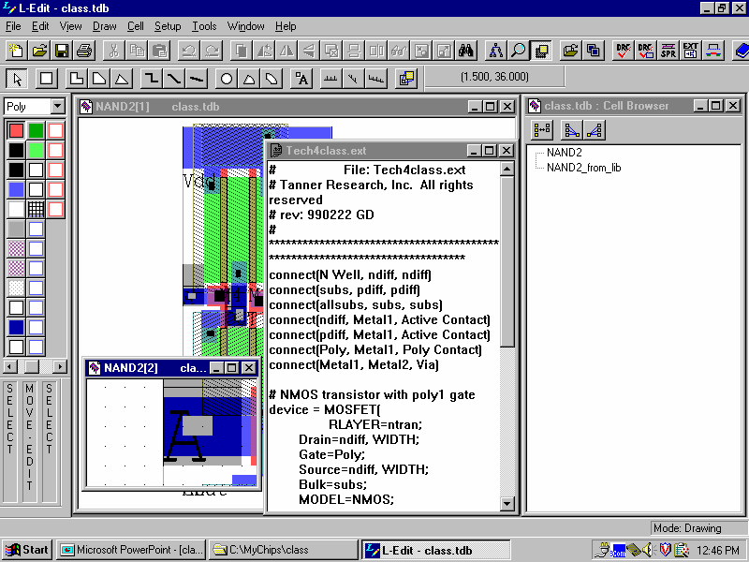
1.3 VLSI Design Styles
Layout editor
Menu Bar
Toolbar
Drawing Tools
Layer Palette
Locator
Cell Browser
Mouse Buttons Bar
Text Windows
Layout Windows
Status Bar

Slide 8
1.3 VLSI Design Styles
Common digital cells
AND
OR
INV
NAND
NOR
IN1 | IN2 | OUT
0 | 0 | 0
1 | 0 | 0
0 | 1 | 0
1 | 1 | 1
IN1 | IN2 | OUT
0 | 0 | 0
1 | 0 | 1
0 | 1 | 1
1 | 1 | 1
 | IN | OUT
 | 0 | 1
 | 1 | 0
 | 1 | 0
 | 1 | 1
IN1 | IN2 | OUT
0 | 0 | 1
1 | 0 | 1
0 | 1 | 1
1 | 1 | 0
IN1 | IN2 | OUT
0 | 0 | 1
1 | 0 | 0
0 | 1 | 0
1 | 1 | 0

Slide 9
1.3 VLSI Design Styles
Vdd
Contact
Metal layer
Vdd
IN2
Poly layer
IN2
IN1
OUT
OUT
Diffusion layer
IN1
p-type
transistor
GND
n-type
transistor
GND
IN1
IN2
OUT

Slide 10
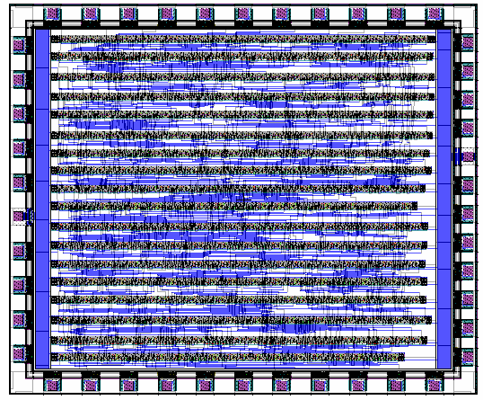
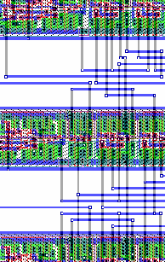

1.3 VLSI Design Styles
Vdd
Contact
Metal layer
Vdd
IN2
Poly layer
IN2
IN1
OUT
OUT
Diffusion layer
IN1
p-type
transistor
GND
n-type
transistor
GND
IN1
IN2
OUT
Power (Vdd)-Rail
© 2022 Springer Verlag
Ground (GND)-Rail

Slide 11
1.3 VLSI Design Styles
Standard cell layout with
a feedthrough cell
Standard cell layout using
over-the-cell (OTC routing
Power
Pad
Pad
Standard Cells
Ground
Pad
Power
Pad
Pad
Standard Cells
Ground
Pad
A
A
VDD
VDD
A’
GND
GND
A’
© 2022 Springer Verlag
Feedthrough
Cell
Routing Channel

Slide 12
1.3 VLSI Design Styles
Layout with macro cells
RAM
PLA
VDD
RAM
Standard Cell Block
GND
PLA
© 2022 Springer Verlag
Pad
Routing Regions

Slide 13
1.3 VLSI Design Styles
Field-programmable gate array (FPGA)
Logic Element
LB
LB
LB
LB
LB
LB
LB
LB
Switchbox
Connection
SB
SB
SB
SB
SB
SB
LB
LB
LB
LB
LB
LB
LB
LB
LB
SB
SB
SB
SB
SB
SB
LB
LB
LB
LB
LB
LB
LB
LB
LB
LB
© 2022 Springer Verlag

Slide 14
1.4 Layout Layers and Design Rules
Layout layers of an inverter cell with external connections
Inverter Cell
Vdd
Metal2
Contact
Metal1
Via
polysilicon
p/n diffusion
GND
© 2022 Springer Verlag
External
Connections

Slide 15
1.4 Layout Layers and Design Rules
Categories of design rules
Size rules, such as minimum width: The dimensions of any component (shape), e.g., length of a boundary edge or area of the shape, cannot be smaller than given minimum values. These values vary across different metal layers.
Separation rules, such as minimum separation: Two shapes, either on the same layer or on adjacent layers, must be a minimum (rectilinear or Euclidean diagonal) distance apart.
Overlap rules, such as minimum overlap: Two connected shapes on adjacent layers must have a certain amount of overlap due to inaccuracy of mask alignment to previously-made patterns on the wafer.

Slide 16
1.4 Layout Layers and Design Rules
Categories of design rules
λ: smallest meaningful technology-dependent unit of length
a
λ
c
Minimum Width: a
Minimum Separation: b, c, d
Minimum Overlap: e
e
d
b
© 2022 Springer Verlag

Slide 17
1.5 Physical Design Optimizations
Types of constraints
Technology constraints enable fabrication for a specific technology node and are derived from technology restrictions. Examples include minimum layout widths and spacing values between layout shapes.
Electrical constraints ensure the desired electrical behavior of the design. Examples include meeting maximum timing constraints for signal delay and staying below maximum coupling capacitances.
Geometry (design methodology) constraints are introduced to reduce the overall complexity of the design process. Examples include the use of preferred wiring directions during routing, and the placement of standard cells in rows.

Slide 18
1.6 Algorithms and Complexity
Runtime complexity
Runtime complexity: the time required by the algorithm to complete as a function of some natural measure of the problem size, allows comparing the scalability of various algorithms
Complexity is represented in an asymptotic sense, with respect to the input size n, using big-Oh notation or O(…)
Runtime t(n) is order f (n), written as t(n) = O(f (n)) when
where k is a real number
Example: t(n) = 7n! + n² + 100, then t(n) = O(n!)
because n! is the fastest growing term as n  .

Slide 19
1.6 Algorithms and Complexity
Runtime complexity
Example: Exhaustively Enumerating All Placement Possibilities
  Given: n cells
  Task: find a single-row placement of n cells with minimum total wirelength by using exhaustive enumeration.
  Solution: The solution space consists of n! placement options. If generating and evaluating the wirelength of each possible placement solution takes 1 s and
  n = 20, the total time needed to find an optimal solution would be 77,147 years!
A number of physical design problems have best-known algorithm complexities that grow exponentially with n, e.g., O(n!), O(n^{n}), and O(2^{n}).
Many of these problems are NP-hard (NP: non-deterministic polynomial time)
  No known algorithms can ensure, in a time-efficient manner, globally optimal solution
Heuristic algorithms are used to find near-optimal solutions

Slide 20
1.6 Algorithms and Complexity
Heuristic algorithms
Deterministic: All decisions made by the algorithm are repeatable, i.e., not random. One example of a deterministic heuristic is Dijkstra’s shortest path algorithm.
Stochastic: Some decisions made by the algorithm are made randomly, e.g., using a pseudo-random number generator. Thus, two independent runs of the algorithm will produce two different solutions with high probability. One example of a stochastic algorithm is simulated annealing.
In terms of structure, a heuristic algorithm can be
  Constructive: The heuristic starts with an initial, incomplete (partial) solution and adds components until a complete solution is obtained.
  Iterative: The heuristic starts with a complete solution and repeatedly improves the current solution until a preset termination criterion is reached.

Slide 21
1.6 Algorithms and Complexity
Heuristic algorithms
Problem Instance
Constructive Algorithm
Initial Solution
Iterative Improvement
no
Termination
Criterion Met?
yes
Return Best-Seen Solution

Slide 22
1.7 Graph Theory Terminology
Graph
Hypergraph
Multigraph
b
b
b
a
e
f
c
a
a
d
e
g
f
d
c
c
© 2022 Springer Verlag

Slide 23
1.7 Graph Theory Terminology
Directed graphs with cycles
Directed acyclic graph
c
f
c
f
a
a
g
a
b
b
g
b
d
d
e
e

Slide 24
1.7 Graph Theory Terminology
Undirected graph with maximum node degree 3
Directed tree
b
a
a
f
b
c
d
c
e
g
e
f
g
h
i
j
k
d

Slide 25
1.7 Graph Theory Terminology
Rectilinear minimum spanning
tree (RMST)
Rectilinear Steiner minimum
tree (RSMT)
b (2,6)
b (2,6)
Steiner point
c (6,4)
c (6,4)
a (2,1)
a (2,1)
© 2022 Springer Verlag

Slide 26
1.8 Common EDA Terminology
Netlist
a
x
(a: N₁)
(b: N₂)
(c: N₅)
(x: IN1 N₁, IN2 N₂, OUT N₃)
(y: IN1 N₁, IN2 N₂, OUT N₄)
(z: IN1 N₃, IN2 N₄, OUT N₅)
(N₁: a, x.IN1, y.IN1)
(N₂: b, x.IN2, y.IN2)
(N₃: x.OUT, z.IN1)
(N₄: y.OUT, z.IN2)
(N₅: z.OUT, c)
N₃
N₅
N₁
N₂
z
c
N₄
b
y
Pin-Oriented Netlist
Net-Oriented Netlist

Slide 27
1.8 Common EDA Terminology
Connectivity graph
a
x
a
x
N₃
N₅
N₁
N₂
z
c
z
c
N₄
b
y
b
y

Slide 28
1.8 Common EDA Terminology
Connectivity matrix
a
b
x
y
z
c
a
0
0
1
1
0
0
a
b
0
0
1
1
0
0
x
x
1
1
0
2
1
0
N₃
N₅
N₁
N₂
z
c
y
1
1
2
0
1
0
N₄
z
0
0
1
1
0
1
b
y
c
0
0
0
0
1
0

Slide 29
1.8 Common EDA Terminology
Distance metric between two points P₁ (x₁,y₁) and P₂ (x₂,y₂)
with n = 2: Euclidean distance
n = 1: Manhattan distance
P₁ (2,4)
d_{M} = 7
d_{E} = 5
d_{M} = 7
P₂ (6,1)

Slide 30
Summary of Chapter 1
IC production experienced huge growth since the 1960s
  Exponential decrease in transistor size, cost per transistor, power per transistor, etc
IC design is impossible without simplification and automation
  Row-based standard-cell layout with design rules
  Traditionally, each step in the VLSI design flow has been automated separately by software (CAD) tools
Software tools use sophisticated algorithms
  Many problems in physical design are NP-hard – solved by heuristic algorithms that find near-optimal solutions
  Deterministic versus stochastic algorithms
  Constructive algorithms versus iterative improvement
  Graph algorithms – deal with circuit connectivity
  Computational geometry – deal with circuit layout

