Slide 1
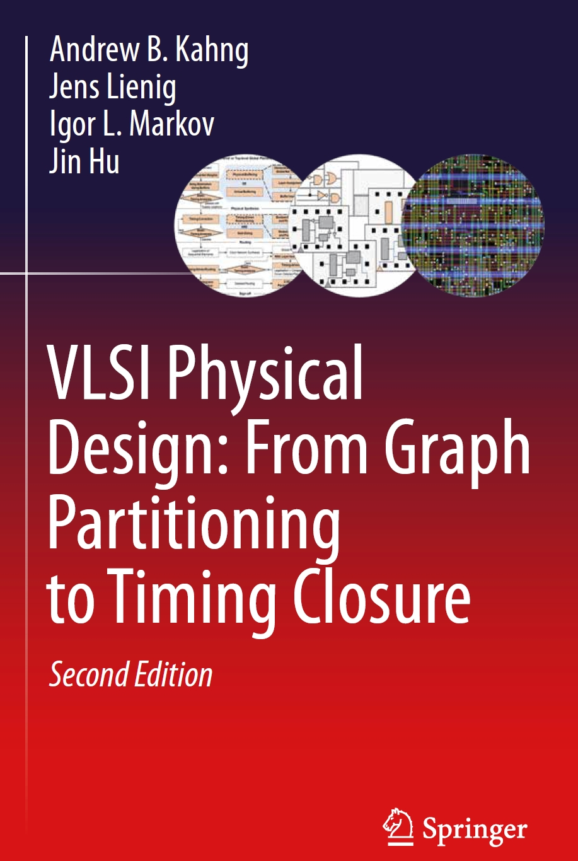
Chapter 6 – Detailed Routing

Slide 2
Chapter 6 – Detailed Routing
6.1 Terminology
6.2 Horizontal and Vertical Constraint Graphs
  6.2.1 Horizontal Constraint Graphs
  6.2.2 Vertical Constraint Graphs
6.3 Channel Routing Algorithms
  6.3.1 Left-Edge Algorithm
  6.3.2 Dogleg Routing
6.4 Switchbox Routing
  6.4.1 Terminology
  6.4.2 Switchbox Routing Algorithms
6.5 Over-the-Cell Routing Algorithms
  6.5.1 OTC Routing Methodology
  6.5.2 OTC Routing Algorithms
6.6 Modern Challenges in Detailed Routing

Slide 3
6 Detailed Routing
System Specification
Partitioning
Architectural Design
ENTITY test is
port a: in bit;
end ENTITY test;
Functional Design
and Logic Design
Chip Planning
Circuit Design
Placement
Physical Design
Clock Tree Synthesis
Physical Verification
and Signoff
DRC
LVS
ERC
Signal Routing
Fabrication
Timing Closure
Packaging and Testing
Chip

Slide 4
6 Detailed Routing
Routing
Multi-Stage Routing of Signal Nets
Global
Routing
Detailed
Routing
Timing-Driven Routing
Large Single- Net Routing
Geometric Techniques
Coarse-grain
assignment of
routes to
routing regions
(Chap. 5)
Fine-grain
assignment
of routes to
routing tracks
(Chap. 6)
Net topology
optimization
and resource
allocation to
critical nets
(Chap. 8)
Power (VDD)
and Ground
(GND)
routing
(Chap. 3)
Non-Manhattan
and
clock routing
(Chap. 7)

Slide 5
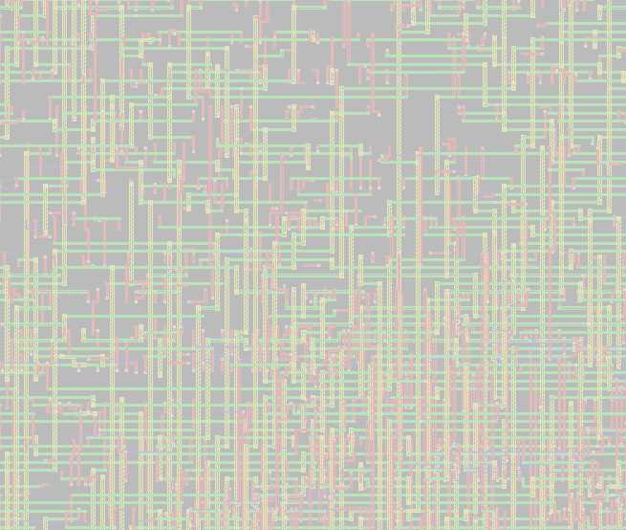
6 Detailed Routing
The objective of detailed routing is to assign route segments of signal nets
to specific routing tracks, vias, and metal layers in a manner
consistent with given global routes of those nets
Similar to global routing
  Use physical wires to do connections
  Estimating the wire resistance and capacitance, which determines
  whether the design meets timing requirements
Detailed routing techniques are applied within routing regions, such as
  channels (Sec. 6.3), switchboxes (Sec. 6.4) , and global routing cells (Sec. 6.5)
Detailed routers must account for manufacturing rules and the impact
of manufacturing faults (Sec. 6.6)

Slide 6
6 Detailed Routing
Detailed Routing Stages
  Assign routing tracks
  Perform entire routing – no open connection left
  Search and repair – resolving all the physical design rules
  Perform optimizations, e.g. add redundant vias (reduce resistivity, better yield)
6
Notes:
6

Slide 7
6 Detailed Routing
Global Routing
Detailed Routing
N₃
N₃
N₁
N₁
N₂
N₂
N₃
N₃
N₃
N₃
N₁
N₁
N₂
N₁
N₁
N₂
Horizontal
Segment
Vertical
Segment
Via

Slide 8
6.1 Terminology
B
E
Channel and Switchbox Routing
E
Horizontal
Channel Tracks
B
B
B
B
C
D
B
C
D
E
D
B
Vertical Channel Tracks
A
C
A
B
B
C

Slide 9
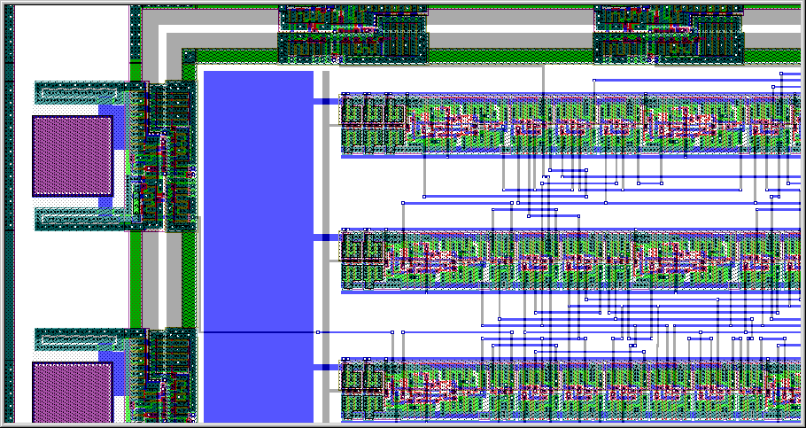
6.1 Terminology
Channel Routing
Standard Cell Row
External Pad
Power Rail
Channel
© 2022 Springer Verlag

Slide 10
6.1 Terminology
Two-Layer Channel Routing
Three-Layer OTC Routing
OTC: Over the cell
B
B
C
D
B
C
Cell Area
B
B
C
D
B
C
A
C
A
B
B
C
A
C
A
B
B
C
Cell Area
Metal1
Metal3
© 2022 Springer Verlag
Metal2
Via

Slide 11
6.1 Terminology
Columns
a
b
c
d
e
f
g
B
0
B
C
D
B
C
Vertical Segment
(Branch)
1
Channel
Height
2
Tracks
Horizontal Segment
(Trunk)
3
A
C
A
B
0
B
C
Pin Locations
© 2022 Springer Verlag

Slide 12
6.1 Terminology
Horizontal Constraint
Assumption: one layer for horizontal routing
A horizontal constraint exists between two nets
if their horizontal segments overlap
A
C
B
Horizontally
constrained
A
B
C
© 2022 Springer Verlag
Horizontally unconstrained

Slide 13
6.1 Terminology
Vertical Constraint
A vertical constraint exists between two nets if they have pins
in the same column
The vertical segment coming from the top must “stop” before overlapping
with the vertical segment coming from the bottom in the same column
A
B
A
B
A
B
B
A
B
A
B
A
© 2022 Springer Verlag
Vertically constrained
without conflict
Vertically constrained with a vertical conflict

Slide 14
6.2 Horizontal and Vertical Constraint Graphs
6.1 Terminology
6.2 Horizontal and Vertical Constraint Graphs
  6.2.1 Horizontal Constraint Graphs
  6.2.2 Vertical Constraint Graphs
6.3 Channel Routing Algorithms
  6.3.1 Left-Edge Algorithm
  6.3.2 Dogleg Routing
6.4 Switchbox Routing
  6.4.1 Terminology
  6.4.2 Switchbox Routing Algorithms
6.5 Over-the-Cell Routing Algorithms
  6.5.1 OTC Routing Methodology
  6.5.2 OTC Routing Algorithms
6.6 Modern Challenges in Detailed Routing

Slide 15
6.2 Horizontal and Vertical Constraint Graphs
The relative positions of nets in a channel routing instance can be modeled
by horizontal and vertical constraint graphs
These graphs are used to
  initially predict the minimum number of tracks that are required
  detect potential routing conflicts

Slide 16
6.3.1 Horizontal Constraint Graphs
Column a b c d e f g h i j k
0
B
D
E
B
F
G
0
D
0
0
A
C
E
C
E
A
F
H
0
H
G
S(b)
= {A, B, C}
Let S(col) denote the set of nets that pass through column col
S(col) contains all nets that either (1) are connected to a pin in column col
or (2) have pin connections to both the left and right of col
Since horizontal segments cannot overlap, each net in S(col) must be assigned
to a different track in column col
S(col) represents the lower bound on the number of tracks in colum col;
lower bound of the channel height is given by maximum cardinality of any S(col)

Slide 17
6.3.1 Horizontal Constraint Graphs
Column a b c d e f g h i j k
0
B
D
E
B
F
G
0
D
0
0
A
C
E
C
E
A
F
H
0
H
G
0
B
D
E
B
F
G
0
D
0
0
A
B
C
D
E
F
G
H
A
C
E
C
E
A
F
H
0
H
G

Slide 18
6.3.1 Horizontal Constraint Graphs
Column a b c d e f g h i j k
0
B
D
E
B
F
G
0
D
0
0
A
C
E
C
E
A
F
H
0
H
G
S(a) = {A}
S(b) = {A,B,C}
S(c) = {A,B,C,D,E}
S(d) = {A,B,C,D,E}
S(e) = {A,B,D,E}
S(f) = {A,D,F}
S(g) = {D,F,G}
S(h) = {D,G,H}
S(i) = {D,G,H}
S(j) = {G,H}
S(k) = {G}
S(a)
S(b)
S(c)
S(d)
S(e)
S(f)
S(g)
S(h)
S(i)
S(j)
S(k)
0
B
D
E
B
F
G
0
D
0
0
A
B
C
D
E
F
G
H
A
C
E
C
E
A
F
H
0
H
G

Slide 19
6.3.1 Horizontal Constraint Graphs
Column a b c d e f g h i j k
0
B
D
E
B
F
G
0
D
0
0
A
C
E
C
E
A
F
H
0
H
G
S(a) = {A}
S(b) = {A,B,C}
S(c) = {A,B,C,D,E}
S(d) = {A,B,C,D,E}
S(e) = {A,B,D,E}
S(f) = {A,D,F}
S(g) = {D,F,G}
S(h) = {D,G,H}
S(i) = {D,G,H}
S(j) = {G,H}
S(k) = {G}
S(a)
S(b)
S(c)
S(d)
S(e)
S(f)
S(g)
S(h)
S(i)
S(j)
S(k)
0
B
D
E
B
F
G
0
D
0
0
A
B
C
D
E
F
G
H
A
C
E
C
E
A
F
H
0
H
G

Slide 20
6.3.1 Horizontal Constraint Graphs
Column a b c d e f g h i j k
0
B
D
E
B
F
G
0
D
0
0
A
C
E
C
E
A
F
H
0
H
G
S(c)
S(f)
S(g)
S(i)
0
B
D
E
B
F
G
0
D
0
0
S(c)
S(f)
S(g)
S(i)
A
A
G
B
C
B
F
H
D
C
E
F
D
G
E
H
A
C
E
C
E
A
F
H
0
H
G

Slide 21
6.3.1 Horizontal Constraint Graphs
Column a b c d e f g h i j k
0
B
D
E
B
F
G
0
D
0
0
A
C
E
C
E
A
F
H
0
H
G
S(c)
S(f)
S(g)
S(i)
A
G
B
F
H
Lower bound on the number of tracks = 5
C
D
E

Slide 22
6.3.1 Horizontal Constraint Graphs
Column a b c d e f g h i j k
0
B
D
E
B
F
G
0
D
0
0
A
C
E
C
E
A
F
H
0
H
G
Graphical Representation
A
S(c)
S(f)
S(g)
S(i)
F
A
G
B
F
H
G
C
D
B
D
E
H
E
C

Slide 23
6.3.2 Vertical Constraint Graphs
A directed edge e(i,j)  E connects nodes i and j
if the horizontal segment of net i must be located above net j
A
A
B
B

Slide 24
6.3.2 Vertical Constraint Graphs
0
B
D
E
B
F
G
0
D
0
0
A
C
E
C
E
A
F
H
0
H
G
A
24

Slide 25
6.3.2 Vertical Constraint Graphs
0
B
D
E
B
F
G
0
D
0
0
A
C
E
C
E
A
F
H
0
H
G
B
C
A
25

Slide 26
6.3.2 Vertical Constraint Graphs
0
B
D
E
B
F
G
0
D
0
0
A
C
E
C
E
A
F
H
0
H
G
B
D
C
E
A
26

Slide 27
6.3.2 Vertical Constraint Graphs
0
B
D
E
B
F
G
0
D
0
0
A
C
E
C
E
A
F
H
0
H
G
B
D
C
E
A
27

Slide 28
6.3.2 Vertical Constraint Graphs
0
B
D
E
B
F
G
0
D
0
0
A
C
E
C
E
A
F
H
0
H
G
Vertical Constraint Graph (VCG)
B
D
Note: an edge that can be derived
by transitivity is not included,
such as edge (B,C)
C
E
A
28

Slide 29
6.3.2 Vertical Constraint Graphs
0
B
D
E
B
F
G
0
D
0
0
A
C
E
C
E
A
F
H
0
H
G
B
D
F
C
E
A
29

Slide 30
6.3.2 Vertical Constraint Graphs
0
B
D
E
B
F
G
0
D
0
0
A
C
E
C
E
A
F
H
0
H
G
B
D
G
F
C
E
A
30

Slide 31
6.3.2 Vertical Constraint Graphs
0
B
D
E
B
F
G
0
D
0
0
A
C
E
C
E
A
F
H
0
H
G
B
D
G
F
C
E
A
H
31

Slide 32
6.3.2 Vertical Constraint Graphs
0
B
D
E
B
F
G
0
D
0
0
A
C
E
C
E
A
F
H
0
H
G
B
D
G
E
F
C
A
H

Slide 33
6.3.2 Vertical Constraint Graphs
A
B
B
A
A
B
B
Net splitting
B
0
A
B
B
A
Cyclic conflict

Slide 34
6.3 Channel Routing Algorithms
6.1 Terminology
6.2 Horizontal and Vertical Constraint Graphs
  6.2.1 Horizontal Constraint Graphs
  6.2.2 Vertical Constraint Graphs
6.3 Channel Routing Algorithms
  6.3.1 Left-Edge Algorithm
  6.3.2 Dogleg Routing
6.4 Switchbox Routing
  6.4.1 Terminology
  6.4.2 Switchbox Routing Algorithms
6.5 Over-the-Cell Routing Algorithms
  6.5.1 OTC Routing Methodology
  6.5.2 OTC Routing Algorithms
6.6 Modern Challenges in Detailed Routing

Slide 35
6.3.1 Left-Edge Algorithm
Based on the VCG and the zone representation,
greedily maximizes the usage of each track
  VCG: assignment order of nets to tracks
  Zone representation: determines which nets may share the same track
Each net uses only one horizontal segment (trunk)

Slide 36
6.3.1 Left-Edge Algorithm
Input: channel routing instance CR
Output: track assignments for each net
curr_track = 1 // start with topmost track
nets_unassigned = Netlist
while (nets_unassigned != Ø) // while nets still unassigned
VCG = VCG(CR) // generate VCG and zone
ZR = ZONE_REP(CR) // representation
SORT(nets_unassigned,start column) // find left-to-right ordering
// of all unassigned nets
for (i =1 to |nets_unassigned|)
curr_net = nets_unassigned[i]
if (PARENTS(curr_net) == Ø && // if curr_net has no parent
(TRY_ASSIGN(curr_net,curr_track)) // and does not cause
// conflicts on curr_track,
ASSIGN(curr_net,curr_track) // assign curr­_net
REMOVE(nets_unassigned,curr_net)
curr_track = curr_track + 1 // consider next track

Slide 37
6.3.1 Left-Edge Algorithm – Example
0
A
D
E
A
F
G
0
D
I
J
J
B
C
E
C
E
B
F
H
I
H
G
I

Slide 38
6.3.1 Left-Edge Algorithm – Example
0
A
D
E
A
F
G
0
D
I
J
J
B
C
E
C
E
B
F
H
I
H
G
I
Generate VCG and zone representation
A
D
J
A
G
B
H
E
I
G
C
I
C
H
F
D
J
E
F
B

Slide 39
6.3.1 Left-Edge Algorithm – Example
A
D
J
A
G
B
H
E
I
G
C
I
C
H
F
D
J
E
F
B
Consider next track
Find left-to-right ordering of all unassigned nets
If curr_net has no parents and does not cause conflicts on curr_track
assign curr_net
curr_track = 1:
Net A
Net J
  4. Delete placed nets (A, J ) in VCG and zone represenation

Slide 40
6.3.1 Left-Edge Algorithm – Example
0
A
D
E
A
F
G
0
D
I
J
J
curr_track = 1
2
3
4
5
B
C
E
C
E
B
F
H
I
H
G
I
40

Slide 41
6.3.1 Left-Edge Algorithm – Example
D
G
B
H
E
I
G
C
I
C
H
F
D
E
F
B
Consider next track
Find left-to-right ordering of all unassigned nets
If curr_net has no parents and does not cause conflicts on curr_track
assign curr_net
curr_track = 2:
Net D
  4. Delete placed nets (D ) in VCG and zone representation

Slide 42
6.3.1 Left-Edge Algorithm – Example
0
A
D
E
A
F
G
0
D
I
J
J
1
curr_track = 2
3
4
5
B
C
E
C
E
B
F
H
I
H
G
I
42

Slide 43
6.3.1 Left-Edge Algorithm – Example
G
B
H
E
I
G
C
I
C
H
F
E
F
B
Consider next track
Find left-to-right ordering of all unassigned nets
If curr_net has no parents and does not cause conflicts on curr_track
assign curr_net
curr_track = 3:
Net E
Net G
  4. Delete placed nets (E, G ) in VCG and zone representation

Slide 44
6.3.1 Left-Edge Algorithm – Example
0
A
D
E
A
F
G
0
D
I
J
J
1
2
curr_track = 3
4
5
B
C
E
C
E
B
F
H
I
H
G
I
44

Slide 45
6.3.1 Left-Edge Algorithm – Example
B
H
I
C
I
C
H
F
F
B
Consider next track
Find left-to-right ordering of all unassigned nets
If curr_net has no parents and does not cause conflicts on curr_track
assign curr_net
curr_track = 4:
Net C
Net F
Net I
  4. Delete placed nets (C, F, I ) in VCG and zone representation

Slide 46
6.3.1 Left-Edge Algorithm – Example
0
A
D
E
A
F
G
0
D
I
J
J
1
2
3
curr_track = 4
5
B
C
E
C
E
B
F
H
I
H
G
I
46

Slide 47
6.3.1 Left-Edge Algorithm – Example
B
H
H
B
Consider next track
Find left-to-right ordering of all unassigned nets
If curr_net has no parents and does not cause conflicts on curr_track
assign curr_net
curr_track = 5:
Net B
Net H
  4. Delete placed nets (B, H ) in VCG and zone representation

Slide 48
6.3.1 Left-Edge Algorithm – Example
0
A
D
E
A
F
G
0
D
I
J
J
1
2
3
4
curr_track = 5
B
C
E
C
E
B
F
H
I
H
G
I
Routing result
48

Slide 49
6.3.2 Dogleg Routing
Improving left-edge algorithm by net splitting
Two advantages:
  Alleviates conflicts in VCG
  Number of tracks can often be reduced
A
B
B
Net splitting
B
0
A
Dogleg

Slide 50
6.3.2 Dogleg Routing
Conflict alleviation using a dogleg
A
B
B
A
A
B
B
B
B
0
A
B
A

Slide 51
6.3.2 Dogleg Routing
Track reduction using a dogleg
A
A
B
B
0
A
A
B
B
0
0
B
0
C
C
0
B
0
C
C

Slide 52
6.3.2 Dogleg Routing
Splitting p-pin nets (p > 2) into p  1 horizontal segments
Net splitting occurs only in columns that contain a pin of the given net
After net splitting, the algorithm follows the left-edge algorithm
Net splitting
A
A
B
B
0
A
B₁
B₂
C
0
B
0
C
C

Slide 53
6.3.2 Dogleg Routing
A
A
B
B
0
A
A
A
B
B
0
B
0
B
0
C
C
C
0
B
0
C
C
Channel routing problem
VCG without net splitting
Channel routing solution
A
A
B
B
0
A
A
B
B
0
A
A
B₂
B₁
B₂
C
B₁
C
0
B
0
C
C
0
B
0
C
C
© 2022 Springer Verlag
Net splitting
VCG with net splitting
Channel routing solution

Slide 54
6.4 Switchbox Routing
6.1 Terminology
6.2 Horizontal and Vertical Constraint Graphs
  6.2.1 Horizontal Constraint Graphs
  6.2.2 Vertical Constraint Graphs
6.3 Channel Routing Algorithms
  6.3.1 Left-Edge Algorithm
  6.3.2 Dogleg Routing
6.4 Switchbox Routing
  6.4.1 Terminology
  6.4.2 Switchbox Routing Algorithms
6.5 Over-the-Cell Routing Algorithms
  6.5.1 OTC Routing Methodology
  6.5.2 OTC Routing Algorithms
6.6 Modern Challenges in Detailed Routing

Slide 55
6.4 Switchbox Routing
B
E
E
B
B
D
E
D
B
Fixed dimensions and pin connections on all four sides
Defined by four vectors TOP, BOT, LEFT, RIGHT
Switchbox routing algorithms are usually derived from (greedy) channel routing algorithms

Slide 56
6.4 Switchbox Routing
R = {0, 1, 2, …, 8} x {0, 1, 2, … , 7}
TOP = (1, 2, … , 7) = [0, D, F, H, E, C, C]
BOT = (1, 2, … , 7) = [0, 0, G, H, B, B, H]
LEFT = (1, 2, … , 6) = [A, 0, D, F, G, 0]
RIGHT = (1, 2, … , 6) = [B, H, A, C, E, C]
Column
a
b
c
d
e
f
g
0
D
F
H
E
C
C
0
D
F
H
E
C
C
6
0
C
0
C
5
G
E
?
G
E
Track
4
F
C
F
C
3
D
A
D
A
2
0
H
0
H
1
A
B
A
B
0
0
G
H
B
B
H
0
0
G
H
B
B
H

Slide 57
6.4 Switchbox Routing – Example
TOP = (1, 2, … , 7) = [0, D, F, H, E, C, C]
BOT = (1, 2, … , 7) = [0, 0, G, H, B, B, H]
LEFT = (1, 2, … , 6) = [A, 0, D, F, G, 0]
RIGHT = (1, 2, … , 6) = [B, H, A, C, E, C]
Column
a
b
c
d
e
f
g
0
D
F
H
E
C
C
6
0
C
5
G
E
Track
4
F
C
3
D
A
2
0
H
1
A
B
0
0
G
H
B
B
H

Slide 58
6.4 Switchbox Routing – Example
TOP = (1, 2, … , 7) = [0, D, F, H, E, C, C]
BOT = (1, 2, … , 7) = [0, 0, G, H, B, B, H]
LEFT = (1, 2, … , 6) = [A, 0, D, F, G, 0]
RIGHT = (1, 2, … , 6) = [B, H, A, C, E, C]
Column
a
b
c
d
e
f
g
0
D
F
H
E
C
C
0
D
F
H
E
C
C
6
0
C
0
C
5
G
E
G
E
Track
F
C
4
F
C
3
D
A
D
A
2
0
H
0
H
1
A
B
A
B
0
0
G
H
B
B
H
0
0
G
H
B
B
H

Slide 59
6.5 Over-the-Cell Routing Algorithms
6.1 Terminology
6.2 Horizontal and Vertical Constraint Graphs
  6.2.1 Horizontal Constraint Graphs
  6.2.2 Vertical Constraint Graphs
6.3 Channel Routing Algorithms
  6.3.1 Left-Edge Algorithm
  6.3.2 Dogleg Routing
6.4 Switchbox Routing
  6.4.1 Terminology
  6.4.2 Switchbox Routing Algorithms
6.5 Over-the-Cell Routing Algorithms
  6.5.1 OTC Routing Methodology
  6.5.2 OTC Routing Algorithms
6.6 Modern Challenges in Detailed Routing

Slide 60
6.5 Over-the-Cell Routing Algorithms
Standard cells are placed back-to-back or without routing channels
Metal layers are usually represented by a coarse routing grid
made up of global routing cells (gcells)
Back to back
Without routing channels

Slide 61
6.5 Over-the-Cell Routing Algorithms
Standard cells are placed back-to-back or without routing channels
Metal layers are usually represented by a coarse routing grid
made up of global routing cells (gcells)
gcells
Metal3
Metal1
(Cells: Back to back)
Metal2 (Cell ports)
Metal4
etc.

Slide 62
6.5 Over-the-Cell Routing Algorithms
Standard cells are placed back-to-back or without routing channels
Metal layers are usually represented by a coarse routing grid
made up of global routing cells (gcells)
gcells
Metal3
Metal1
(Without routing channels)
Metal2 (Cell ports)
Metal4
etc.

Slide 63
6.5 Over-the-Cell Routing Algorithms
Standard cells are placed back-to-back or without routing channels
Metal layers are usually represented by a coarse routing grid
made up of global routing cells (gcells)
Layers that are not obstructed by standard cells
are typically used for over-the-cell (OTC) routing
Nets are globally routed using gcells and then detail-routed

Slide 64
6.5 Over-the-Cell Routing Algorithms
Three-layer approach
Metal3 is used for over-the-cell (OTC) routing
Metal1
(Cells)
Metal3
Metal2
(Ports)

Slide 65
6.5 Over-the-Cell Routing Algorithms
Three-layer approach
Metal3 is used for over-the-cell (OTC) routing
Cell Area
Metal3
B
B
C
D
B
C
Metal2
Metal1
A
C
A
B
B
C
Cell Area

Slide 66
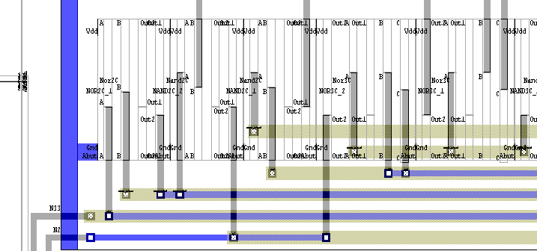
GND
Metal1
Standard cell
(only ports shown)
Metal2
Metal3
Ports in Metal2
OTC routing
in Metal3
Channel
Channel routing in Metal1, Metal2
and Metal3
© 2022 Springer Verlag

Slide 67
6.6 Modern Challenges in Detailed Routing
6.1 Terminology
6.2 Horizontal and Vertical Constraint Graphs
  6.2.1 Horizontal Constraint Graphs
  6.2.2 Vertical Constraint Graphs
6.3 Channel Routing Algorithms
  6.3.1 Left-Edge Algorithm
  6.3.2 Dogleg Routing
6.4 Switchbox Routing
  6.4.1 Terminology
  6.4.2 Switchbox Routing Algorithms
6.5 Over-the-Cell Routing Algorithms
  6.5.1 OTC Routing Methodology
  6.5.2 OTC Routing Algorithms
6.6 Modern Challenges in Detailed Routing

Slide 68
6.6 Modern Challenges in Detailed Routing
Manufacturers today use different configurations of metal layers and widths
to accommodate high-performance designs
Detailed routing is becoming more challenging, for example:
  Vias connecting wires of different widths inevitably block additional routing resources on the layer with the smaller wire pitch
  Advanced lithography techniques used in manufacturing require
  stricter enforcement of preferred routing direction on each layer

Slide 69
6.6 Modern Challenges in Detailed Routing
Representative layer stacks for 130 nm - 32 nm
technology nodes
W2
U2
W1
U1
E2
E2
E1
E1
B3
B3
E1
B2
B2
B3
B1
B2
M6
B1
B2
C2
B1
M5
M5
B1
C1
M5
M4
M4
M4
M4
M4
M3
M3
M3
M3
M3
© 2022 Springer Verlag
M2
M2
M2
M2
M2
M1
M1
M1
M1
M1
130 nm
90 nm
65 nm
45 nm
32 nm

Slide 70
6.6 Modern Challenges in Detailed Routing
Semiconductor manufacturing yield is a key concern in detailed routing
  Redundant vias and wiring segments as backups
  (via doubling and non-tree routing)
  Manufacturability constraints (design rules) become more restrictive
  Forbidden pitch rules prohibit routing wires at certain distances apart,
  but allows smaller or greater spacings
Detailed routers must account for manufacturing rules and the impact
of manufacturing faults
  Via defects: via doubling during or after detailed routing
  Interconnect defects: add redundant wires to already routed nets
  Antenna-induced defects: detailed routers limit the ratio of metal to gate area
  on each metal layer

Slide 71
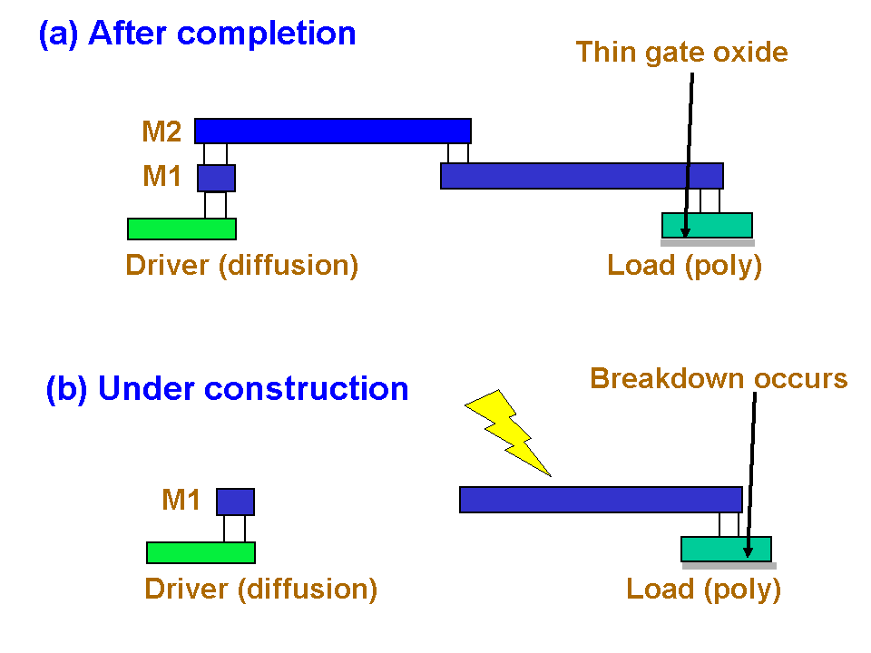
6.6 Modern Challenges in Detailed Routing
Antenna Effect
Source: http://en.wikipedia.org/wiki/Antenna_effect
71

Slide 72
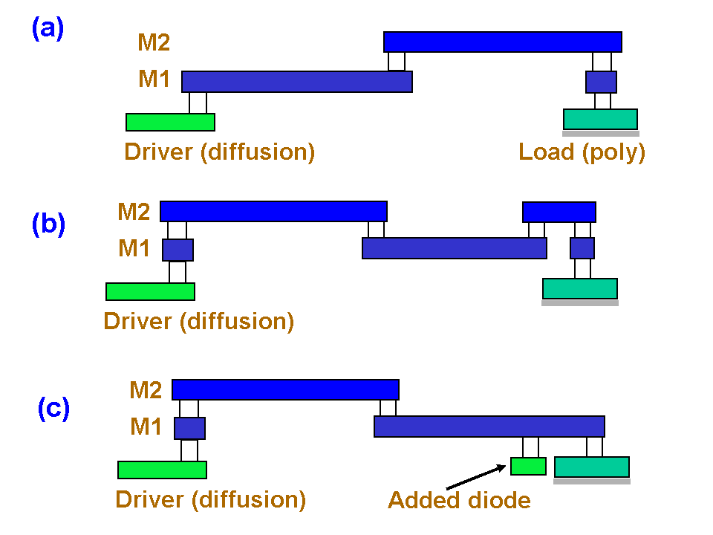
6.6 Modern Challenges in Detailed Routing
Antenna Effect Fix
Source: http://en.wikipedia.org/wiki/Antenna_effect
72

Slide 73
Summary of Chapter 6 – Context
Detailed routing is invoked after global routing
Usually takes about as much time as global routing
  For heavily congested designs can take much longer
Generates specific track assignments for each connection
  Tries to follow "suggestions" made by global routing,
  but may alter them if necessary
  A small number of failed global routed (disconnected, overcapacity)
  can be tolerated
More affected by technology & manufacturing constraints than global routing
  Must satisfy design rules

Slide 74
Summary of Chapter 6 – Routing Regions
Breaks down the layout area into regions
  Channels have net terminals (pins) on two sides
  Switch-boxes have terminals on four sides
  Channels are joined at switchboxes
When the number of metal layers is >3, use over-the-cell (OTC) routing
  Divide the layout region into a grid of global routing cells (gcells)
  OTC routing makes the locations of cells, obstacles and pins less important
  Channel and switchbox routing can be used during OTC routing
  when upper metal layers are blocked (by wide buses, other wires, etc.)
The capacity of a region is limited by the number of tracks it contains
  Channels, switchboxes, gcells

Slide 75
Summary of Chapter 6 – Algorithms and Data Structures
Horizontal and vertical constraint graphs capture constraints
that must be satisfied by valid routes
Simplest algorithms for detailed routing are greedy
  Every step satisfies immediate constraints with minimal routing cost
  Use as few bends as possible (doglegs are used when additional bends
  are needed)
  Very fast, do a surprisingly good job in many cases
  Insufficient for congested designs
Switchbox routing algorithms are usually derived from channel routing algorithms
Strategy 1: Do not create congested designs and rely on greedy algorithms
Strategy 2: Accommodate congested designs and develop stronger algorithms

Slide 76
Summary of Chapter 6 – Modern Challenges
Variable-pitch wire stacks
  Not addressed in the literature until 2008
Satisfying more complex design rules
  Min spacing between wires and devices
  Forbidden pitch rules
  Antenna rules
Soft rules
  Do not need to be satisfied
  Can improve yield by decreasing the probability of defects
Redundant vias
  In case some vias are poorly manufactured
Redundant wires
  In case some wires get disconnected

