Slide 1
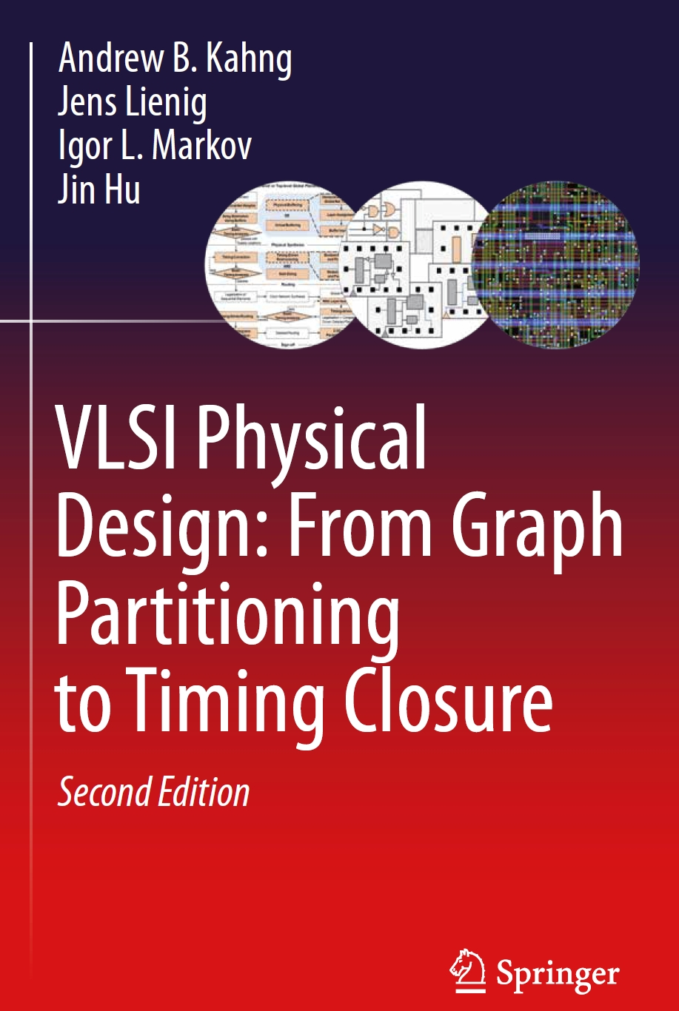
Chapter 8 – Timing Closure

Slide 2
Chapter 8 – Timing Closure
8.1 Introduction
8.2 Timing Analysis and Performance Constraints
    8.2.1 Static Timing Analysis
    8.2.2 Delay Budgeting with the Zero-Slack Algorithm
8.3 Timing-Driven Placement
  8.3.1 Net-Based Techniques
  8.3.2 Embedding STA into Linear Programs for Placement
8.4 Timing-Driven Routing
  8.4.1 The Bounded-Radius, Bounded-Cost Algorithm
  8.4.2 Prim-Dijkstra Tradeoff
  8.4.3 Minimization of Source-to-Sink Delay
8.5 Physical Synthesis
  8.5.1 Gate Sizing
  8.5.2 Buffering
  8.5.3 Netlist Restructuring
8.6 Performance-Driven Design Flow
8.7 Conclusions

Slide 3
8.1 Introduction
System Specification
Partitioning
Architectural Design
ENTITY test is
port a: in bit;
end ENTITY test;
Functional Design
and Logic Design
Chip Planning
Circuit Design
Placement
Physical Design
Clock Tree Synthesis
Physical Verification
and Signoff
DRC
LVS
ERC
Signal Routing
Fabrication
Timing Closure
Packaging and Testing
Chip

Slide 4
8.1 Introduction
IC layout must satisfy geometric constraints, electrical constraints,
power & thermal constraints as well as timing constraints
  Setup (long-path) constraints
  Hold (short-path) constraints
Chip designers must complete timing closure
  Optimization process that meets timing constraints
  Integrates point optimizations discussed in previous chapters, e.g.,
  placement and routing, with specialized methods to improve circuit performance

Slide 5
8.1 Introduction
Components of timing closure covered in this lecture:
Timing-driven placement (Sec. 8.3) minimizes signal delays
when assigning locations to circuit elements
Timing-driven routing (Sec. 8.4) minimizes signal delays
when selecting routing topologies and specific routes
Physical synthesis (Sec. 8.5) improves timing by changing the netlist
  Sizing transistors or gates: increasing the width:length ratio of transistors
  to decrease the delay or increase the drive strength of a gate
  Inserting buffers into nets to decrease propagation delays
  Restructuring the circuit along its critical paths
Performance-driven physical design flow (Sec. 8.6)

Slide 6
8.1 Introduction
Timing optimization engines must estimate circuit delays quickly and accurately to improve circuit timing
Timing optimizers adjust propagation delays through circuit components,
with the primary goal of satisfying timing constraints, including
  Setup (long-path) constraints, which specify the amount of time a data input signal should be stable (steady) before the clock edge for each storage element
  (e.g., flip-flop or latch)
  Hold-time (short-path) constraints, which specify the amount of time a data input signal should be stable after the clock edge at each storage element

Slide 7
8.1 Introduction
Timing closure is the process of satisfying timing constraints
through layout optimizations and netlist modifications
Industry jargon: “the design has closed timing”

Slide 8
8.2 Timing Analysis and Performance Constraints
8.1 Introduction
8.2 Timing Analysis and Performance Constraints
    8.2.1 Static Timing Analysis
    8.2.2 Delay Budgeting with the Zero-Slack Algorithm
8.3 Timing-Driven Placement
  8.3.1 Net-Based Techniques
  8.3.2 Embedding STA into Linear Programs for Placement
8.4 Timing-Driven Routing
  8.4.1 The Bounded-Radius, Bounded-Cost Algorithm
  8.4.2 Prim-Dijkstra Tradeoff
  8.4.3 Minimization of Source-to-Sink Delay
8.5 Physical Synthesis
  8.5.1 Gate Sizing
  8.5.2 Buffering
  8.5.3 Netlist Restructuring
8.6 Performance-Driven Design Flow
8.7 Conclusions

Slide 9
8.2 Timing Analysis and Performance Constraints
Sequential circuit, “unrolled” in time
Combinational Logic
Copy 1
Combinational Logic
Copy 2
Combinational Logic
Copy 3
FF
FF
FF
Clock
Storage elements
Combinational logic
© 2022 Springer Verlag

Slide 10
8.2 Timing Analysis and Performance Constraints
Main delay concerns in sequential circuits
  Gate delays are due to gate transitions
  Wire delays are due to signal propagation along wires
  Clock skew is due to the difference in time the sequential elements activate
Need to quickly estimate sequential circuit timing
  Perform static timing analysis (STA)
  Assume clock skew is negligible, postpone until after clock network synthesis

Slide 11
8.2.1 Static Timing Analysis
STA: assume worst-case scenario where every gate transitions
Given combinational circuit, represent as directed acyclic graph (DAG)
  Every edge (node) has weight = wire (gate) delay
Compute the slack = RAT – AAT for each node
  RAT is the required arrival time, latest time signal can transition
  AAT is the actual arrival time
  By convention, AAT is defined at the output of every node
Negative slack at any output means the circuit does not meet timing
Positive slack at all outputs means the circuit meets timing

Slide 12
8.2.1 Static Timing Analysis
Combinational circuit as DAG
a
(0.15)
y (2)
(0.2)
w (2)
(0.2)
f
(0.1)
b
(0.1)
x (1)
(0.3)
(0.25)
z (2)
c
(0.1)
a (0)
(0.15)
y (2)
(0)
(0.1)
(0.2)
s
(0)
b (0)
(0.1)
x (1)
w (2)
(0.2)
f (0)
(0.6)
(0.3)
(0.25)
© 2022 Springer Verlag
c (0)
(0.1)
z (2)

Slide 13
8.2.1 Static Timing Analysis
Compute AATs at each node:
where FI(v) is the fanin nodes, and t(u,v) is the delay between u and v
(AATs of inputs are given)
a (0)
(0.15)
y (2)
A 0
A 3.2
(0)
(0.1)
(0.2)
s
(0)
b (0)
(0.1)
x (1)
w (2)
(0.2)
f (0)
A 0
A 0
A 1.1
A 5.65
A 5.85
(0.6)
(0.3)
(0.25)
c (0)
(0.1)
z (2)
A 0.6
A 3.4
© 2022 Springer Verlag

Slide 14
8.2.1 Static Timing Analysis
Compute RATs at each node:
where FO(v) are the fanout nodes, and t(u,v) is the delay between u and v
(RATs of outputs are given)
a (0)
(0.15)
y (2)
R 0.95
R 3.1
(0)
(0.1)
(0.2)
s
(0)
b (0)
(0.1)
x (1)
w (2)
(0.2)
f (0)
R -0.35
R -0.35
R 0.75
R 5.3
R 5.5
(0.6)
(0.3)
(0.25)
c (0)
(0.1)
z (2)
R 0.95
R 3.05
© 2022 Springer Verlag

Slide 15
8.2.1 Static Timing Analysis
Compute slacks at each node:
a (0)
(0.15)
y (2)
A 0
R 0.95
S 0.95
A 3.2
R 3.1
S -0.1
(0)
(0.1)
(0.2)
s
(0)
b (0)
(0.1)
x (1)
w (2)
(0.2)
f (0)
A 0
R -0.35
S -0.35
A 0
R -0.35
S -0.35
A 1.1
R 0.75
S -0.35
A 5.65
R 5.3
S -0.35
A 5.85
R 5.5
S -0.35
(0.6)
(0.3)
(0.25)
c (0)
(0.1)
z (2)
A 0.6
R 0.95
S 0.35
A 3.4
R 3.05
S -0.35
© 2022 Springer Verlag

Slide 16
8.2.2 Delay Budgeting with the Zero-Slack Algorithm
Establish timing budgets for nets
  Gate and wire delays must be optimized during timing driven layout design
  Wire delays depend on wire lengths
  Wire lengths are not known until after placement and routing
Delay budgeting with the zero-slack algorithm
  Let v_{i} be the logic gates
  Let e_{i} be the nets
  Let DELAY(v) and DELAY(e) be the delay of the gate and net, respectively
  Timing budget TB(v) of a gate corresponds to DELAY(v) + DELAY(e)

Slide 17
8.2.2 Delay Budgeting with the Zero-Slack Algorithm
Input: timing graph G(V,E)
Output: timing budgets TB for each v  V
do
(AAT,RAT,slack) = STA(G)
foreach (v_{i}  V)
TB[v_{i}] = DELAY(v_{i}) + DELAY(e_{i})
slack_{min} = ∞
foreach (v  V)
if ((slack[v] < slack_{min}) and (slack[v] > 0))
slack_{min} = slack[v]
v_{min} = v
if (slack_{min} ≠ ∞)
path = v_{min}
ADD_TO_FRONT(path,BACKWARD_PATH(v_{min},G))
ADD_TO_BACK(path,FORWARD_PATH(v_{min},G))
s = slack_{min} / |path|
for (i = 1 to |path|)
node = path[i] // evenly distribute
TB[node] = TB[node] + s // slack along path
while (slack_{min} ≠ ∞)

Slide 18
8.2.2 Delay Budgeting with the Zero-Slack Algorithm
Forward Path Search (FORWARD_PATH(v_{min},G))
Input: node v_{min} with minimum slack slack_{min}, timing graph G
Output: maximal downstream path path from v_{min} such that no node v  V affects
the slack of path
path = v_{min}
do
flag = false
node = LAST_ELEMENT(path)
foreach (fanout node fo of node)
if ((RAT[fo] == RAT[node] + TB[fo]) and (AAT[fo] == AAT[node] + TB[fo]))
ADD_TO_BACK(path,fo)
flag = true
break
while (flag == true)
REMOVE_FIRST_ELEMENT(path) // remove v_{min}

Slide 19
8.2.2 Delay Budgeting with the Zero-Slack Algorithm
Backward Path Search (BACKWARD_PATH(v_{min},G))
Input: node v_{min} with minimum slack slack_{min}, timing graph G
Output: maximal upstream path path from v_{min} such that no node v  V affects the
slack of path
path = v_{min}
do
flag = false
node = FIRST_ELEMENT(path)
foreach (fanin node fi of node)
if ((RAT[fi] == RAT[node] – TB[fi]) and (AAT[fi] == AAT[node] – TB[fi]))
ADD_TO_FRONT(path,fi)
flag = true
break
while (flag == true)
REMOVE_LAST_ELEMENT(path) // remove v_{min}

Slide 20
8.2.2 Delay Budgeting with the Zero-Slack Algorithm Example
Example: Use the zero-slack algorithm to distribute slack
Format: <AAT, Slack, RAT>, [timing budget]
O₁: <13,4,17>
O₂: <6,8,14>
<1,4,5>
[0]
[0]
I₁
<3,4,7>
2
I₂
<0,5,5>
[0]
[0]
<7,4,11>
<13,4,17>
[0]
4
6
O₁
I₃
<1,6,7>
[0]
[0]
<6,8,14>
3
0
O₂
I₄
[0]
<6,5,11>
<3,5,8>
[0]

Slide 21
8.2.2 Delay Budgeting with the Zero-Slack Algorithm Example
Example: Use the zero-slack algorithm to distribute slack
Format: <AAT, Slack, RAT>, [timing budget]
Find the path with the minimum nonzero slack
O₁: <13,4,17>
O₂: <6,8,14>
<1,4,5>
[0]
[0]
I₁
<3,4,7>
2
I₂
<0,5,5>
[0]
[0]
<7,4,11>
<13,4,17>
[0]
4
6
O₁
I₃
<1,6,7>
[0]
[0]
<6,8,14>
3
0
O₂
I₄
[0]
<6,5,11>
<3,5,8>
[0]

Slide 22
8.2.2 Delay Budgeting with the Zero-Slack Algorithm Example
Example: Use the zero-slack algorithm to distribute slack
Format: <AAT, Slack, RAT>, [timing budget]
Find the path with the minimum slack
Distribute the slacks and update the timing budgets
O₁: <17,0,17>
O₂: <6,8,14>
<1,0,1>
[1]
[1]
I₁
<3,0,4>
2
I₂
<0,2,2>
[0]
[1]
<9,0,9>
<16,0,16>
[1]
4
6
O₁
I₃
<1,4,5>
[0]
[0]
<6,8,14>
3
0
O₂
I₄
[0]
<6,4,10>
<3,4,7>
[0]

Slide 23
8.2.2 Delay Budgeting with the Zero-Slack Algorithm Example
Example: Use the zero-slack algorithm to distribute slack
Format: <AAT, Slack, RAT>, [timing budget]
Find the path with the minimum slack
Distribute the slacks and update the timing budgets
O₁: <17,0,17>
O₂: <6,8,14>
<1,0,1>
[1]
[1]
I₁
<4,0,4>
2
I₂
<0,0,0>
[2]
[1]
<9,0,9>
<16,0,16>
[1]
4
6
O₁
I₃
<1,4,5>
[0]
[0]
<6,8,14>
3
0
O₂
I₄
[0]
<6,4,10>
<3,4,7>
[0]

Slide 24
8.2.2 Delay Budgeting with the Zero-Slack Algorithm Example
Example: Use the zero-slack algorithm to distribute slack
Format: <AAT, Slack, RAT>, [timing budget]
Find the path with the minimum slack
Distribute the slacks and update the timing budgets
O₁: <16,0,16>
O₂: <6,8,14>
<1,0,1>
[1]
[1]
I₁
<4,0,4>
2
I₂
<0,0,0>
[2]
[1]
<9,0,9>
<16,0,16>
[1]
4
6
O₁
I₃
<1,2,3>
[2]
[0]
<6,8,14>
3
0
O₂
I₄
[2]
<6,2,8>
<3,2,5>
[0]

Slide 25
8.2.2 Delay Budgeting with the Zero-Slack Algorithm Example
Example: Use the zero-slack algorithm to distribute slack
Format: <AAT, Slack, RAT>, [timing budget]
Find the path with the minimum slack
Distribute the slacks and update the timing budgets
O₁: <17,0,17>
O₂: <10,4,14>
<1,0,1>
[1]
[1]
I₁
<4,0,4>
2
I₂
<0,0,0>
[2]
[1]
<9,0,9>
<16,0,16>
[1]
4
6
O₁
I₃
<1,0,1>
[3]
<10,4,14>
[0]
3
0
O₂
I₄
[3]
<7,0,7>
<3,1,4>
[0]

Slide 26
8.2.2 Delay Budgeting with the Zero-Slack Algorithm Example
Example: Use the zero-slack algorithm to distribute slack
Format: <AAT, Slack, RAT>, [timing budget]
Find the path with the minimum slack
Distribute the slacks and update the timing budgets
O₁: <17,0,17>
O₂: <10,4,14>
<1,0,1>
[1]
[1]
I₁
<4,0,4>
2
I₂
<0,0,0>
[2]
[1]
<9,0,9>
<16,0,16>
[1]
4
6
O₁
I₃
<1,0,1>
[3]
<10,4,14>
[4]
3
0
O₂
I₄
[3]
<7,0,7>
<3,0,3>
[1]

Slide 27
8.3 Timing-Driven Placement
8.1 Introduction
8.2 Timing Analysis and Performance Constraints
    8.2.1 Static Timing Analysis
    8.2.2 Delay Budgeting with the Zero-Slack Algorithm
8.3 Timing-Driven Placement
  8.3.1 Net-Based Techniques
  8.3.2 Embedding STA into Linear Programs for Placement
8.4 Timing-Driven Routing
  8.4.1 The Bounded-Radius, Bounded-Cost Algorithm
  8.4.2 Prim-Dijkstra Tradeoff
  8.4.3 Minimization of Source-to-Sink Delay
8.5 Physical Synthesis
  8.5.1 Gate Sizing
  8.5.2 Buffering
  8.5.3 Netlist Restructuring
8.6 Performance-Driven Design Flow
8.7 Conclusions
Notes:
27

Slide 28
8.3 Timing-Driven Placement
Timing-driven placement optimizes circuit delay
to satisfy timing constraints
Let T be the set of all timing endpoints
Constraint satisfaction is measured by worst negative slack (WNS)
Or total negative slack (TNS)
Classifications: net-based, path-based, integrated
Notes:
28

Slide 29
8.3.1 Net-Based Techniques
Net weights are added to each net – placer optimizes weighted wirelength
Static net weights: computed before placement (never changes)
  Discrete net weights: where ω₁ > 0, ω₂ > 0, and ω₂ > ω₁
  Continuous net weights: where t is the longest path delay
  and α is a criticality exponent
  Based on net sensitivity to TNS and slack
Notes:
29

Slide 30
8.3.1 Net-Based Techniques
Dynamic net weights: (re)computed during placement
  Estimate slack at every iteration:
  where ΔL is the change in wirelength
  Update net criticality:
  Update net weight:
Variations include updating every j iterations, different relations
between criticality and net weight
if among the top 3% of critical nets
otherwise
Notes:
30

Slide 31
8.3.2 Embedding STA into Linear Programs for Placement
Construct a set of constraints for timing-driven placement
  Physical constraints define locations of cells
  Timing constraints define slack requirements
Optimize an optimization objective
  Improving worst negative slack (WNS)
  Improving total negative slack (TNS)
  Improving a combination of both WNS and TNS
Notes:
31

Slide 32
8.3.2 Embedding STA into Linear Programs for Placement
For physical constraints, let:
  x_{v} and y_{v} be the center of cell v  V
  V_{e} be the set of cells connected to net e  E
  left(e), right(e), bottom(e), and top(e) respectively be the coordinates
  of the left, right, bottom, and top boundaries of e’s bounding box
  δ_{x}(v,e) and δ_{y}(v,e) be pin offsets from x_{v} and y_{v} for v’s pin connected to e

Slide 33
8.3.2 Embedding STA into Linear Programs for Placement
Then, for all v ∈ V_{e}:
Define e’s half-perimeter wirelength (HPWL):
Notes:
33

Slide 34
8.3.2 Embedding STA into Linear Programs for Placement
For timing constraints, let
  t_{GATE}(v_{i},v_{o}) be the gate delay from an input pin v_{i} to the output pin v_{o} for cell v
  t_{NET}(e,u_{o},v_{i}) be net e’s delay from cell u’s output pin u_{o} to cell v’s input pin v_{i}
  AAT(v_{j}) be the arrival time on pin j of cell v

Slide 35
8.3.2 Embedding STA into Linear Programs for Placement
For every input pin v_{i} of cell v :
For every output pin v_{o} of cell v :
For every pin τ_{p} in a sequential cell τ:
Ensure that every slack(τ_{p}) ≤ 0
Notes:
35

Slide 36
8.3.2 Embedding STA into Linear Programs for Placement
Optimize for total negative slack:
Optimize for worst negative slack:
Optimize а linear combination of multiple parameters:
Notes:
36

Slide 37
8.4 Timing-Driven Routing
8.1 Introduction
8.2 Timing Analysis and Performance Constraints
    8.2.1 Static Timing Analysis
    8.2.2 Delay Budgeting with the Zero-Slack Algorithm
8.3 Timing-Driven Placement
  8.3.1 Net-Based Techniques
  8.3.2 Embedding STA into Linear Programs for Placement
8.4 Timing-Driven Routing
  8.4.1 The Bounded-Radius, Bounded-Cost Algorithm
  8.4.2 Prim-Dijkstra Tradeoff
  8.4.3 Minimization of Source-to-Sink Delay
8.5 Physical Synthesis
  8.5.1 Gate Sizing
  8.5.2 Buffering
  8.5.3 Netlist Restructuring
8.6 Performance-Driven Design Flow
8.7 Conclusions
Notes:
37

Slide 38
8.4 Timing-Driven Routing
Timing-driven routing seeks to minimize:
  Maximum sink delay: delay from the source to any sink in a net
  Total wirelength: routed length of the net
For a signal net net, let
  s₀ be the source node
  sinks = {s₁, … ,s_{n}} be the sinks
  G = (V,E) be a corresponding weighted graph where:
  V = {v₀,v₁, … ,v_{n}} represents the source and sink nodes of net, and
  the weight of an edge e(v_{i},v_{j})  E represents the routing cost between v_{i} and v_{j}

Slide 39
8.4 Timing-Driven Routing
For any spanning tree T over G, let:
  radius(T) be the length of the longest source-sink path in T
  cost(T) be the total edge weight of T
Trade off between “shallow” and “light” trees
“Shallow” trees have minimum radius
  Shortest-paths tree
  Constructed by Dijkstra’s Algorithm
“Light” trees have minimum cost
  Minimum spanning tree (MST)
  Constructed by Prim’s Algorithm

Slide 40
8.4 Timing-Driven Routing
2
3
2
2
3
3
6
6
7
5
5
5
s₀
s₀
s₀
radius(T) = 8
cost(T) = 20
“Shallow”
radius(T) = 13
cost(T) = 13
“Light”
radius(T) = 11
cost(T) = 16
Tradeoff between
shallow and light
© 2022 Springer Verlag

Slide 41
8.4.1 The Bounded-Radius, Bounded-Cost Algorithm
Trades off radius for cost by setting upper bounds on both
In the bounded-radius, bounded-cost (BRBC) algorithm, let:
  T_{S} be the shortest-paths tree
  T_{M} be the minimum spanning tree
T_{BRBC} is the tree constructed with parameter ε that satisfies:
When ε = 0, T_{BRBC} has minimum radius
When ε = ∞, T_{BRBC} has minimum cost
and

Slide 42
8.4.2 Prim-Dijkstra Tradeoff
Prim-Dijkstra Tradeoff based on Prim’s algorithm and Dijkstra’s algorithm
From the set of sinks S, iteratively add sink s based on different cost function
  Prim’s algorithm cost function:
  Dijkstra’s algorithm cost function:
  Prim-Dijkstra Tradeoff cost function:
γ is a constant between 0 and 1

Slide 43
8.4.2 Prim-Dijkstra Tradeoff
4
4
7
11
8
8
7
7
9
s₀
9
s₀
radius(T) = 19
cost(T) = 35
γ = 0.25
radius(T) = 15
cost(T) = 39
γ = 0.75

Slide 44
8.4.3 Minimization of Source-to-Sink Delay
Iteratively forms a tree by adding sinks, and optimizes for critical sink(s)
In the critical-sink routing tree (CSRT) problem, minimize:
where α(i) are sink criticalities for sinks s_{i}, and t(s₀,s_{i}) is the delay from s₀ to s_{i}

Slide 45
8.4.3 Minimization of Source-to-Sink Delay
In the critical-sink Steiner tree problem, construct a
minimum-cost Steiner tree T for all sinks except for the most critical sink s_{c}
Add in the critical sink by:
  H₀: a single wire from s_{c} to s₀
  H₁: the shortest possible wire that can join s_{c} to T, so long as the path
  from s₀ to s_{c} is the shortest possible total length
  H_{Best}: try all shortest connections from s_{c} to edges in T and from s_{c} to s₀.
  Perform timing analysis on each of these trees and pick the one
  with the lowest delay at s_{c}

Slide 46
8.5 Physical Synthesis
8.1 Introduction
8.2 Timing Analysis and Performance Constraints
    8.2.1 Static Timing Analysis
    8.2.2 Delay Budgeting with the Zero-Slack Algorithm
8.3 Timing-Driven Placement
  8.3.1 Net-Based Techniques
  8.3.2 Embedding STA into Linear Programs for Placement
8.4 Timing-Driven Routing
  8.4.1 The Bounded-Radius, Bounded-Cost Algorithm
  8.4.2 Prim-Dijkstra Tradeoff
  8.4.3 Minimization of Source-to-Sink Delay
8.5 Physical Synthesis
  8.5.1 Gate Sizing
  8.5.2 Buffering
  8.5.3 Netlist Restructuring
8.6 Performance-Driven Design Flow
8.7 Conclusions
Notes:
46

Slide 47
8.5 Physical Synthesis
Physical synthesis is a collection of timing optimizations to fix negative slack
Consists of creating timing budgets and performing timing corrections
Timing budgets include:
  allocating target delays along paths or nets
  often during placement and routing stages
  can also be during timing correction operations
Timing corrections include:
  gate sizing
  buffer insertion
  netlist restructuring

Slide 48
8.5.1 Gate Sizing
Let a gate v have 3 sizes A, B, C, where:
Gate with a larger size has lower output resistance
When load capacitances are large:
Gate with a smaller size has higher output resistance
When load capacitances are small:

Slide 49
8.5.1 Gate Sizing
Let a gate v have 3 sizes A, B, C, where:
40
40
35
35
33
30
30
30
27
25
A
25
23
24
27
28
21
26
B
Delay (ps)
24
20
18
C
20
15
15
10
5
0.5
1.0
1.5
2.0
2.5
3.0
© 2022 Springer Verlag
Load Capacitance (fF)

Slide 50
8.5.1 Gate Sizing
d
C(d) = 1.5
a
v
e
C(e) = 1.0
b
f
C(f) = 0.5
d
C(d) = 1.5
d
C(d) = 1.5
a
a
v_{A}
e
C(e) = 1.0
v_{C}
e
C(e) = 1.0
b
b
f
C(f) = 0.5
f
C(f) = 0.5
t(v_{A}) = 40
t(v_{C}) = 28

Slide 51
8.5.2 Buffering
Buffer: a series of two serially-connected inverters
Improve delays by
  speeding up the circuit or serving as delay elements
  changing transition times
  shielding capacitive load
Drawbacks:
  Increased area usage
  Increased power consumption

Slide 52
8.5.2 Buffering
d
C(d) = 1
d
C(d) = 1
e
C(e) = 1
e
C(e) = 1
a
a
f
C(f) = 1
v_{B}
f
C(f) = 1
v_{B}
b
b
y
g
C(g) = 1
g
C(g) = 1
C(v_{B}) = 5 fF
t(v_{B}) = 45 ps
h
C(h) = 1
C(v_{B}) = 3 fF
t(v_{B}) = 33 ps
h
C(h) = 1
C(y) = 3 fF
t(y) = t(v_{B}) + t(y) = 66 ps

Slide 53
8.5.3 Netlist Restructuring
Netlist restructuring only changes existing gates, does not change functionality
Changes include
  Cloning: duplicating gates
  Redesign of fanin or fanout tree: changing the topology of gates
  Swapping communicative pins: changing the connections
  Gate decomposition: e.g., changing AND-OR to NAND-NAND
  Boolean restructuring: e.g., applying Boolean laws to change circuit gates
Can also do reverse transformations of above, e.g., downsizing, merging

Slide 54
8.5.3 Netlist Restructuring
Cloning can reduce fanout capacitance
and reduce downstream capacitance
d
C(d) = 1
a
d
C(d) = 1
e
C(e) = 1
v_{A}
e
C(e) = 1
a
b
v_{B}
f
C(f) = 1
f
C(f) = 1
b
g
C(g) = 1
v_{B}
g
C(g) = 1
h
C(h) = 1
h
C(h) = 1
d
d
a
e
b
v
e
a
f
v
f
b
…
g
…
v’
g
…
h
h

Slide 55
8.5.3 Netlist Restructuring
Redesigning the fanin tree can change AATs
a <4>
(1)
a <4>
b <3>
(1)
f <5>
(1)
f <6>
b <3>
(1)
c <1>
(1)
c <1>
(1)
d <0>
d <0>

Slide 56
8.5.3 Netlist Restructuring
Redesigning fanout trees can change delays on specific paths
path₁
path₁
y₁ (1)
(1)
(1)
(1)
(1)
y₂ (1)
y₂ (1)
path₂
path₂

Slide 57
8.5.3 Netlist Restructuring
Swapping commutative pins can change the final delay
a <0>
(1)
c <2>
(1)
(1)
f <5>
(1)
f <3>
b <1>
(1)
b <1>
(1)
c <2>
(2)
a <0>
(2)

Slide 58
8.5.3 Netlist Restructuring
Gate decomposition can change the general structure of the circuit

Slide 59
8.5.3 Netlist Restructuring
Boolean restructuring uses laws or properties,
e.g., distributive law, to change circuit topology
(a + b)(a + c) = a + bc
a <4>
a <4>
(1)
(1)
x <5>
b <1>
b <1>
(1)
x <6>
(1)
c <2>
(1)
c <2>
(1)
y <6>
(1)
(1)
(1)
y <6>
x(a,b,c) = (a + b)(a + c)
y(a,b,c) = (a + c)(b + c)
x(a,b,c) = a + bc
y(a,b,c) = ab + c

Slide 60
8.6 Performance-Driven Design Flow
8.1 Introduction
8.2 Timing Analysis and Performance Constraints
    8.2.1 Static Timing Analysis
    8.2.2 Delay Budgeting with the Zero-Slack Algorithm
8.3 Timing-Driven Placement
  8.3.1 Net-Based Techniques
  8.3.2 Embedding STA into Linear Programs for Placement
8.4 Timing-Driven Routing
  8.4.1 The Bounded-Radius, Bounded-Cost Algorithm
  8.4.2 Prim-Dijkstra Tradeoff
  8.4.3 Minimization of Source-to-Sink Delay
8.5 Physical Synthesis
  8.5.1 Gate Sizing
  8.5.2 Buffering
  8.5.3 Netlist Restructuring
8.6 Performance-Driven Design Flow
8.7 Conclusions
Notes:
60

Slide 61
8.6 Performance-Driven Design Flow
Baseline Physical Design Flow
Floorplanning, I/O placement, power planning
Logic synthesis and technology mapping
Global placement and sequential element legalization
Clock network synthesis
Global routing and layer assignment
Congestion-driven detailed placement and legalization
Detailed routing
Design for manufacturing
Physical verification
Mask optimization and generation

Slide 62
8.6 Performance-Driven Design Flow
Floorplanning Example
Analog-to-Digital and Digital-to-Analog Converter
Analog Processing
Video
Pre/Post-processing Control + DSP
Video
Codec DSP
Embedded Controller for Dataplane Processing
Protocol Processing
Audio
Pre/Post-processing
Audio
Codec
Baseband DSP
PHY
Baseband
MAC/Control
Security
Main Applications
CPU
Memory
© 2022 Springer Verlag

Slide 63
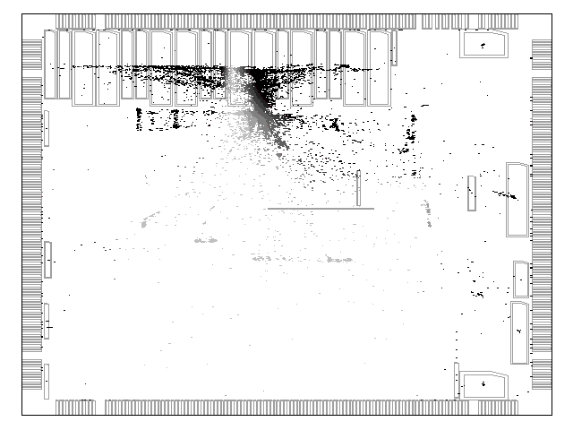
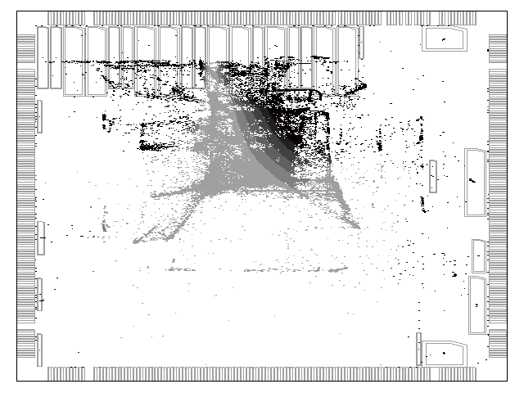
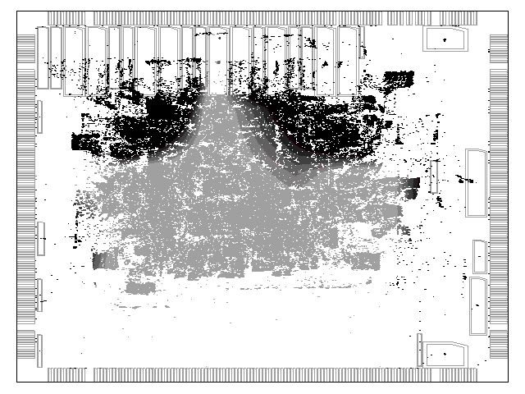
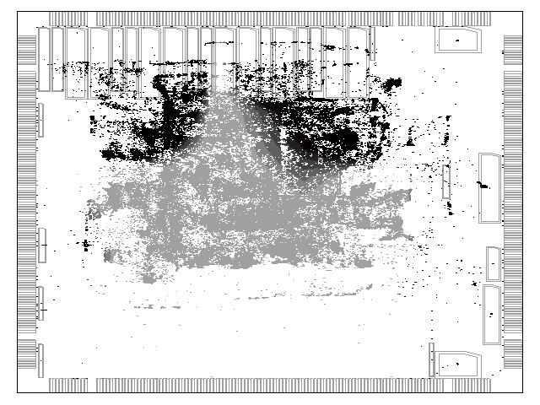
8.6 Performance-Driven Design Flow
Global Placement Example
© 2022 Springer Verlag

Slide 64
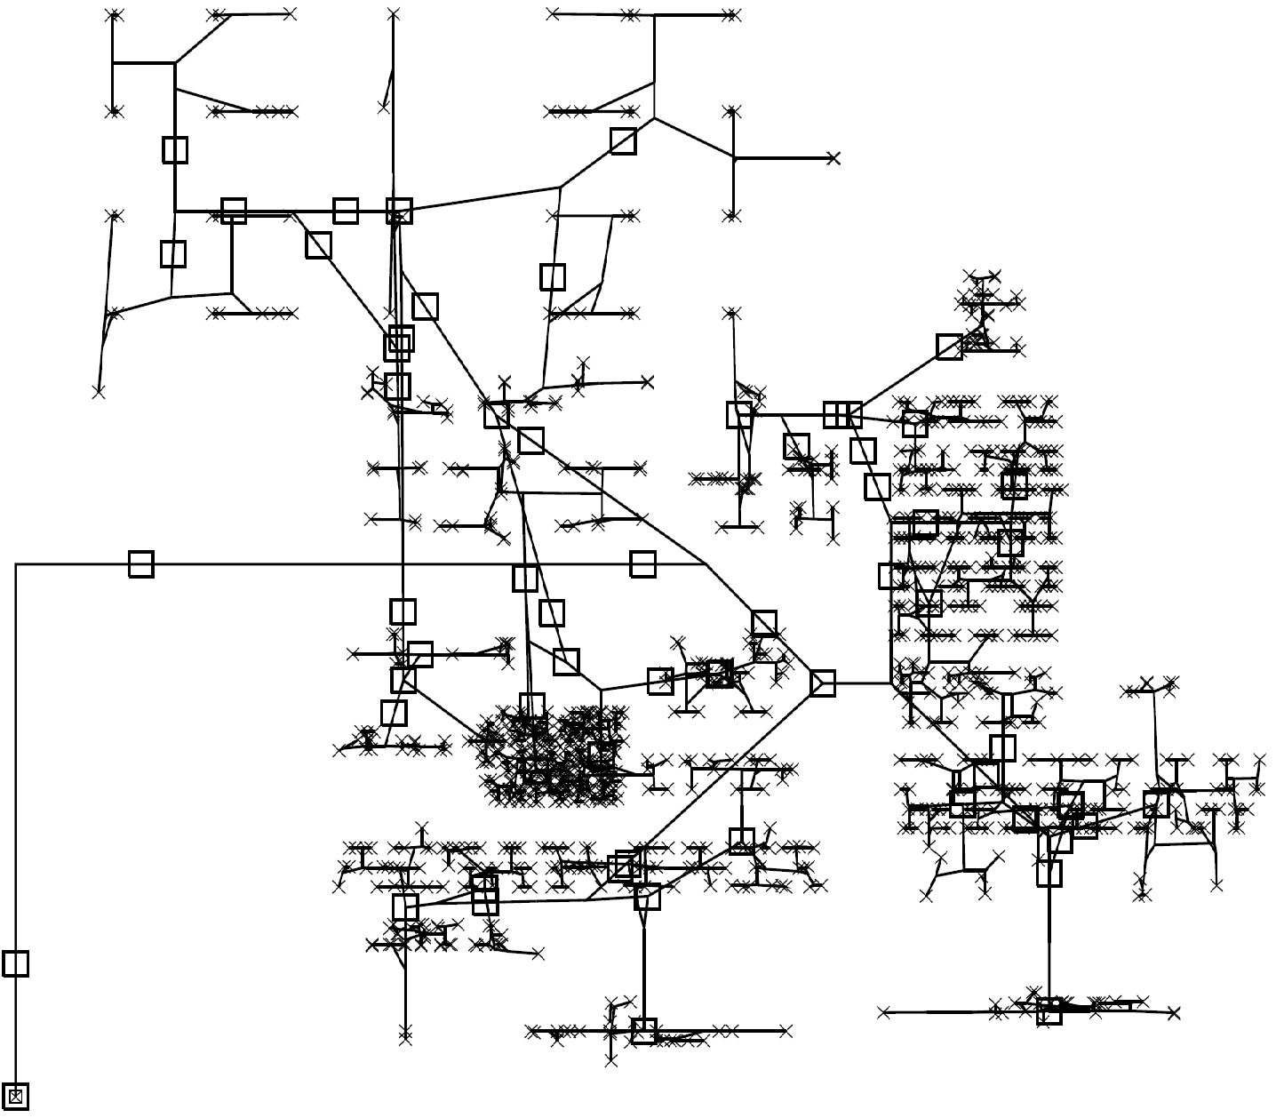
8.6 Performance-Driven Design Flow
Clock Network Synthesis Example
© 2022 Springer Verlag

Slide 65
8.6 Performance-Driven Design Flow
Global Routing Congestion Example
© 2022 Springer Verlag

Slide 66
8.6 Performance-Driven Design Flow
Chip Planning and Logic Design
Performance-Driven
I/O Placement
Block Shaping, Sizing
and Placement
Chip Planning
With Optional Net Weights
Performance-Driven
Block-Level
Delay Budgeting
Trial Synthesis and Floorplanning
Single Global Net Routes
and Buffering
fails
RTL
Timing Estimation
Logic Synthesis and
Technology Mapping
Power Planning
passes
Block-level or Top-level Global Placement
© 2022 Springer Verlag
(see full flow chart in Figure 8.26)

Slide 67
8.6 Performance-Driven Design Flow
Block-level or Top-level Global Placement
Global Placement
Obstacle-Avoiding Single Global Net Topologies
With Optional Net Weights
Physical Buffering
Delay Estimation
Using Buffers
OR
Layer Assignment
Virtual Buffering
fails
Static
Timing Analysis
Buffer Insertion
passes with fixable violations
Physical Synthesis
© 2022 Springer Verlag
(see full flow chart in Figure 8.26)

Slide 68
8.6 Performance-Driven Design Flow
Physical Synthesis
Timing Correction
Timing-Driven
Restructuring
Boolean Restructuring
and Pin Swapping
AND
fails
Static
Timing Analysis
Redesign of Fanin
and Fanout Trees
Gate Sizing
passes
Routing
© 2022 Springer Verlag
(see full flow chart in Figure 8.26)

Slide 69
8.6 Performance-Driven Design Flow
Routing
Legalization of
Sequential Elements
Global Routing
Clock Network Synthesis
With Layer Assignment
fails
Timing-driven
Timing-Driven Routing
Static
Timing Analysis
passes
Legalization + Congestion-Driven Detailed Placement
(Re-)Buffering and
Timing Correction
Detailed Routing
2.5D or 3D
Parasitic Extraction
Sign-off
© 2022 Springer Verlag
(see full flow chart in Figure 8.26)

Slide 70
8.6 Performance-Driven Design Flow
Sign-off
ECO Placement and Routing
fails
fails
Design Rule Checking
Manufacturability,
Electrical, Reliability
Verification
Static Timing Analysis
Layout vs. Schematic
passes
passes
Antenna Effects
Mask Generation
Electrical Rule Checking
© 2022 Springer Verlag
(see full flow chart in Figure 8.26)

Slide 71
Summary of Chapter 8 – Timing Constraints and Timing Analysis
Circuit delay is measured on signal paths
  From primary inputs to sequential elements; from sequentials to primary outputs
  From sequentials to sequentials
Components of path delay
  Gate delays: over-estimated by worst-case transition per gate
  (to ensure fast Static Timing Analysis)
  Wire delays: depend on wire length and (for nets with >2 pins) topology
Timing constraints
  Actual arrival times (AATs) at primary inputs and output pins of sequentials
  Required arrival times (RATs) at primary outputs and input pins of sequentials
Static timing analysis
  Two linear-time traversals compute AATs and RATs for each gate (and net)
  At each timing point: slack = RAT-AAT
  Negative slack = timing violation; critical nets/gates are those with negative slack
Time budgeting: divides prescribed circuit delay into net delay bounds

Slide 72
Summary of Chapter 8 – Timing-Driven Placement
Gate/cell locations affect wire lengths, which affect net delays
Timing-driven placement optimizes gate/cell locations to improve timing
  Interacts with timing analysis to identify critical nets, then biases placement opt.
  Must keep total wirelength low too, otherwise routing will fail
  Timing optimization may increase routing congestion
Placement by net weighting
  The least invasive technique for timing-driven placement
  Performs tentative placement, then changes net weights based on timing analysis
Placement by net budgeting
  Allocates delay bounds for each net; translates delay bounds into length bounds
  Performs placement subject to length constraints for individual nets
Placement based on linear programming
  Placement is cast as a system of equations and inequalities
  Timing analysis and optimization are incorporated using additional inequalities

Slide 73
Summary of Chapter 8 – Timing-Driven Routing
Timing-driven routing has several aspects
  Individual nets: trading longer wires for shorter source-to-sink paths
  Coupling capacitance and signal integrity: parallel wires act as capacitors
  and can slow-down/speed-up signal transitions
  Full-netlist optimization: prioritize the nets that should be optimized first
Individual net optimization
  One extreme: route each source-to-sink path independently (high wirelength)
  Another extreme: use a Minimum Spanning Tree (low wirenegth, high delay)
  Tunable tradeoff: a hybrid of Prim and Dijkstra algorithms
Coupling capacitance and signal integrity
  Parallel wires are only worth attention when they transition at the same time
  Identify critical nets, push neighboring wires further away to limit crosstalk
Full-netlist optimization
  Run trial routing, then run timing analysis to identify critical nets
  Then adjust accordingly, repeat until convergence

Slide 74
Summary of Chapter 8 – Physical Synthesis
Traditionally, place-and-route have been performed after the netlist is known
However, fixing gate sizes and net topologies early
does not account for placement-aware timing analysis
  Gate locations and net routes are not available
Physical synthesis uses information from trial placement to modify the netlist
Net buffering: splits a net into smaller (approx. equal length) segments
  A long net has high capacitance, the driver may be too weak
Gate/buffer sizing: increases driver strength & physical size of a gate
  Large gates have higher input pin capacitance, but smaller driver resistance
  Larger gates can drive larger fanouts, longer nets; faster transitions
  Large gates require more space, larger upstream drivers
Gate cloning: splits large fanouts
  Cloned gates can be placed separately, unlike with a single larger gate

